Slide 1
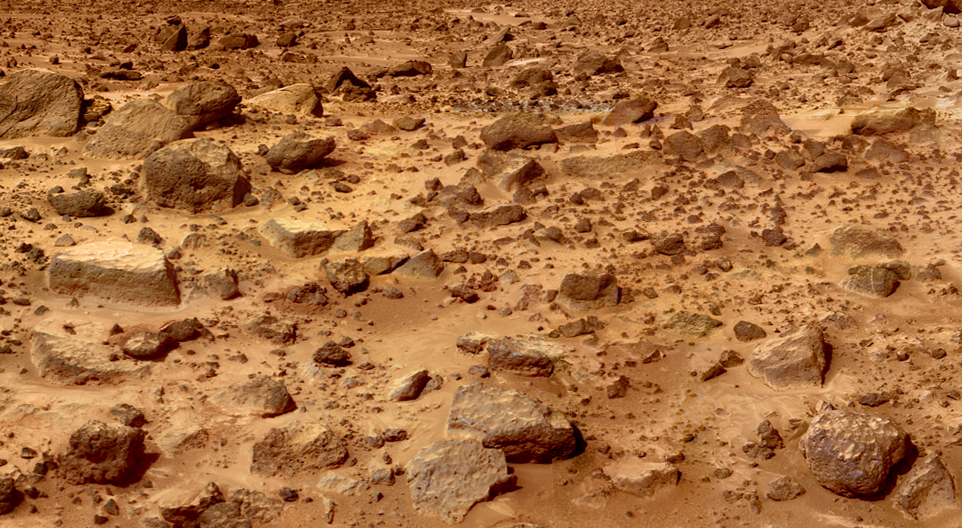
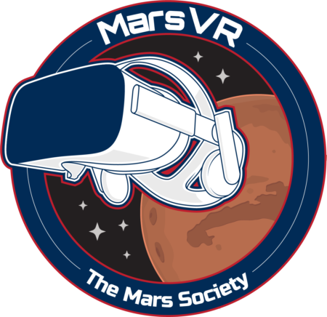
MarsVR
2019 Kickoff

Slide 2
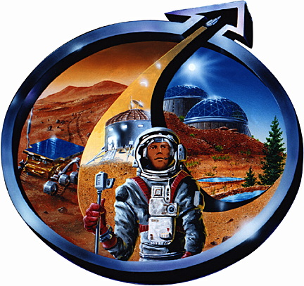
The Mars Society: To Explore and Settle A New World!
Mars Desert Research Station
near Hanksville, Utah
Notes:
I’ve been a volunteer for them nearly 20 years.

Slide 3
Mars Desert Research Station The Mars Society’s Analog Research Program
Program started in 2001
197 Crews
1200+ crewmembers
2 week rotations
6-10 crew per rotation
Researching Geology, Biology, Astronomy, and (most importantly) the “Human Factors Challenges” of living and working on Mars.
Website: mdrs.marssociety.org
(James has maintained the website since 2011)

Slide 4
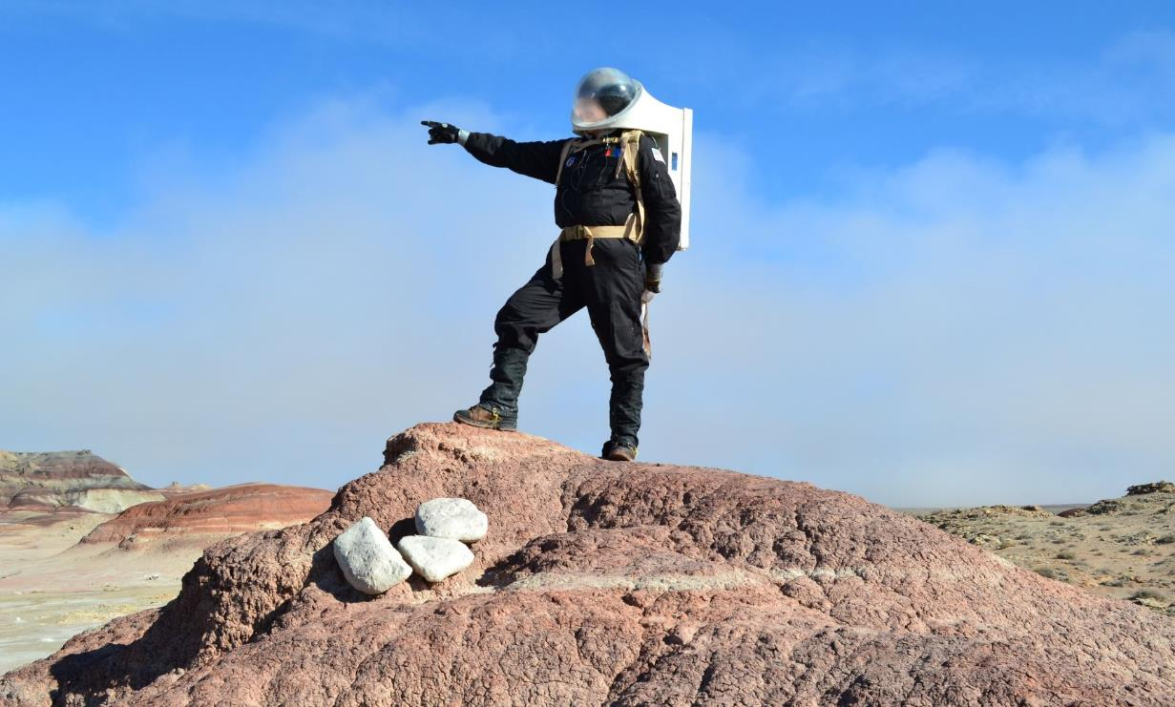
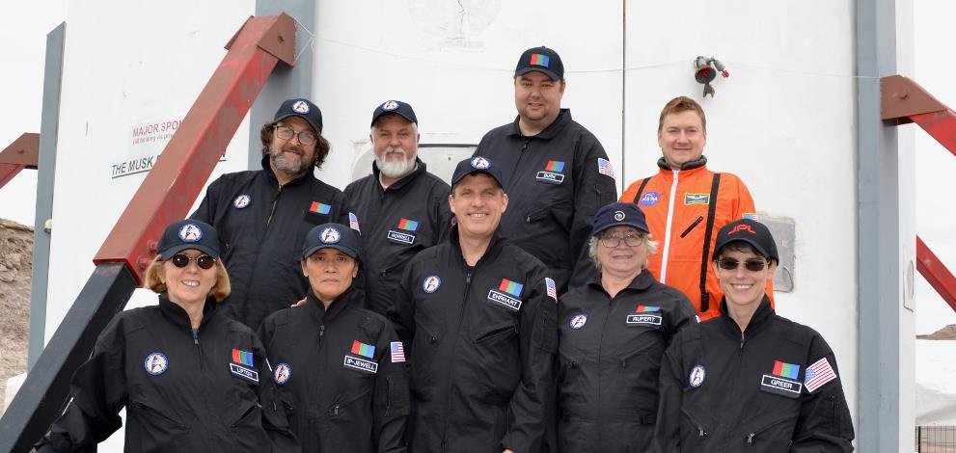
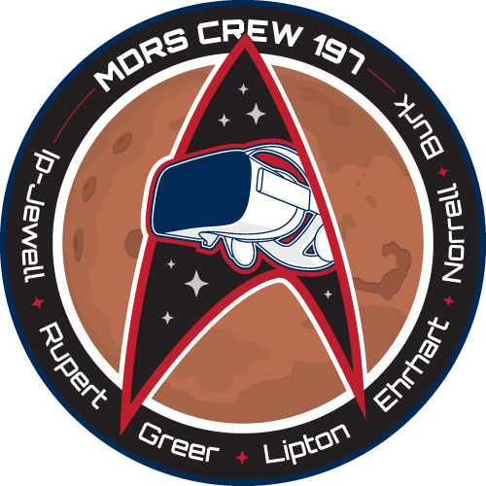
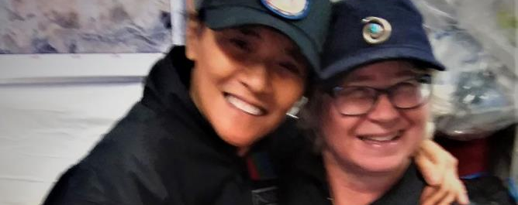
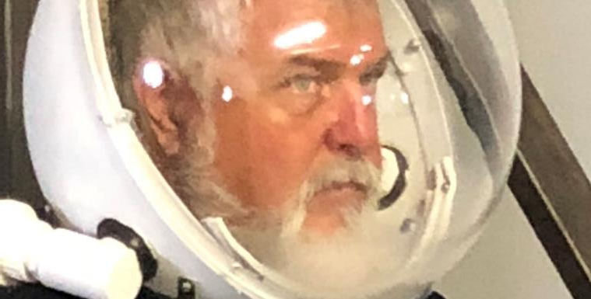

Slide 5
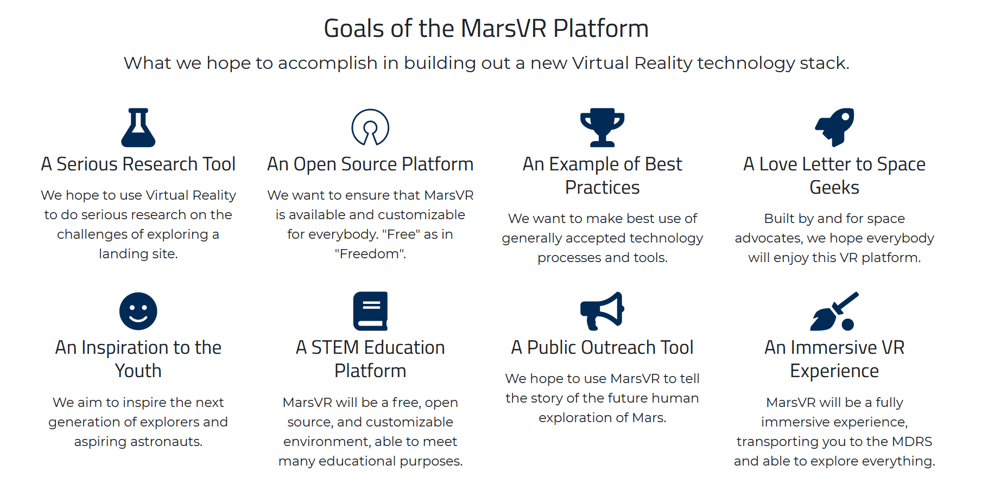

Slide 6
MarsVR Phase 1: MDRS Training Environment
Train crews using VR before they come to the Mars Desert Research Station.
Scan all facilities inside and out with the latest photogrammetry techniques.
Fly a drone to get 1 square mile of the Mars-like terrain in the Utah desert.
Create Training “Missions” covering EVAs, Airlock, ATV procedures and facility acclimation.
Open source the core platform. (Free as in Freedom!)
Sell Steam keys for general public to unlock training to raise further funds.

Slide 7
A Serious Research Tool
MDRS is all about the human factors challenges for the first human landings on Mars. MarsVR supports the work already happening.
MarsVR can pilot the methods of “CrowdExploring” allowing people back on earth to assist the astronauts with landing site exploration.
Piloting out the real-time link between astronauts and VR users, over short and long distances.
We’ll be creating an engineering-grade VR environment & development platform that ultimately can be used (in later phases) to show real Mars terrain via returned data (using MOLA, MOC, HiRISE, CRISM, and other datasets)

Slide 8
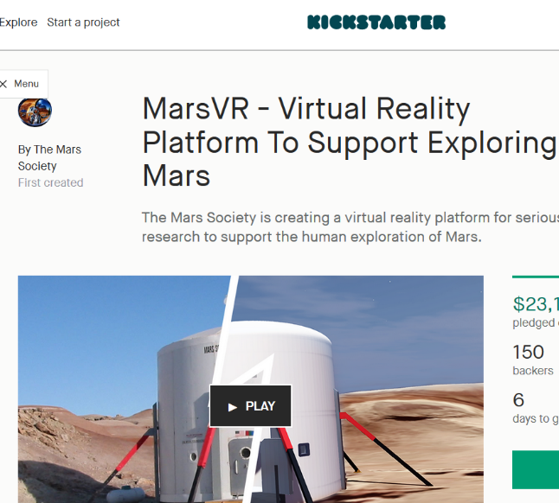
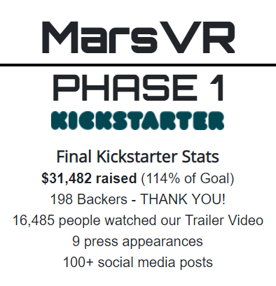

Slide 9
Open Source Environment & Assets
We will license the core VR environment built in Unity with MIT License.
We will provide the actual Unity project to build & customize the environment on Github.
We’ll also share (via Creative Commons maybe?) our MDRS terrain models and all 3-D Models of the base & facilities.
Eventually we will also open source the Mission Content.

Slide 10
Goals of this Call:
Brief New Volunteers on the Project
Provide Access to Tools & Resources
Review Current State
Get Commitments from developers on specific tasks

Slide 11
Current Progress
All Phase 1 assets captured.
Working to clean up in Phase 1 environment.
Early Access build provided to Kickstarter Backers.
Public Beta before end of the year.
Phase 2 Proposal written
Scouting of EVA locations achieved.

Slide 12
Technologies We’re Using
Unity & C# are our development platform & IDE
Photogrammetry (DSLR Photos + LIDAR data)
Drone Image Processing (Pix4D, RealityCapture)
3-D Modeling tools (Blender, Maya)
Google Cloud Storage, Google Drive
Slack for developer communication
Github for open source development
SteamVR & Viveport for software distribution
Wikis, YouTube videos, and other training materials.
K-12 Curriculum (Moodle)

Slide 13
Phase 2
5 Square Miles of terrain
Interactive missions
More EVA missions
Real-time links (Multiplayer)
Improved scans & terrain
Teleoperate rovers / drones
Game Layer?

Slide 14
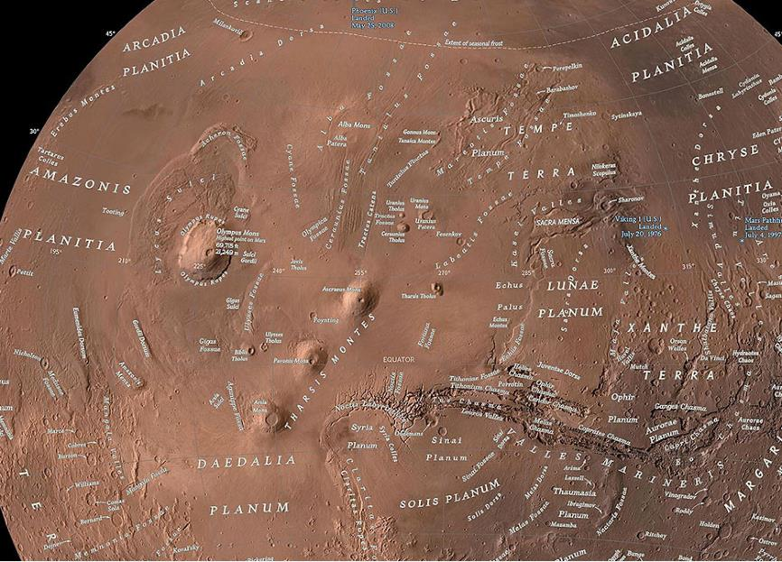
Phase 3 & Beyond
Phase 3 Vision:
Start with the globe of Mars. All named features and landing sites tagged.
“Click” (point) at a location and zoom all the way down to surface level.
Walk around among the real terrain that’s been 3-D rendered using MOLA data and overlaid with orbiter imagery.
Courtesy NatGeo

Slide 15
THANKS!
Follow our progress at:
MarsVR.io

